Slide 1
Peace of Chaos
Piece
The Complex Relationship Between Orexin & the Endocannabinoid System
Leighton Ledesma
BIOL 792 Topics: Brain Stress Circuitries: Orexin Connections
5 April 2024

Slide 2
Chaos Theory
Chaotic Systems are deterministic in that the small differences in initial conditions can drive it to diverging outcomes.
(PDF) CHAOS THEORY AND ITS APPLICATIONS IN OUR REAL LIFE (researchgate.net)
https://en.wikipedia.org/wiki/Chaos_theory
Lorenz Attractor
Butterfly effect

Slide 3
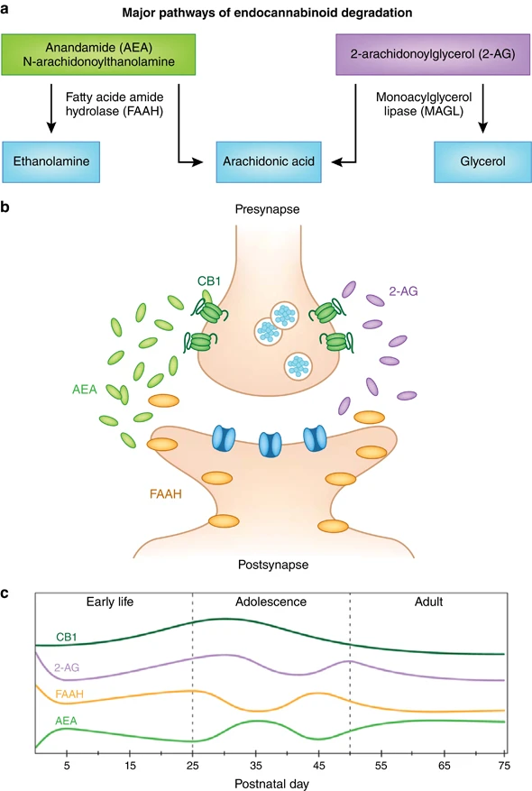
“The Role of the Endocannabinoid System and Genetic Variation in Adolescent Brain Development”
https://www.nature.com/articles/npp2017143

Slide 4
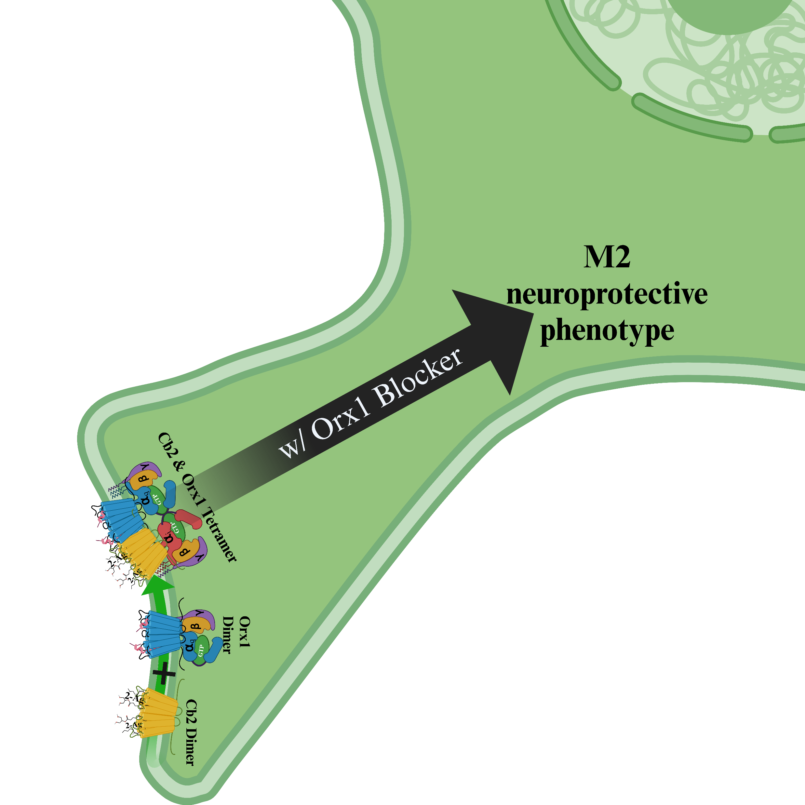
MAGL
MAGL
Notes:
Not satisfied with their model because it doesn’t tell the whole story of what we know

Slide 5
Early Life
Adolescence
Adult
Cb1
2-Ag
FAAH
AEA
https://www.nature.com/articles/npp2017143
Notes:
The paper in the title put together this graph based on a literature review of eCb in brain development of rats
No Y axis so its presumed as concentration of the protein from multiple studies

Slide 6
Also, a Role in Aging, Stress & Development of Diseases Later on in Life
Adult
Cb1
2-Ag
FAAH
AEA
Late Adulthood
75
Notes:
No Y axis so its presumed as concentration of the protein from multiple studies

Slide 7
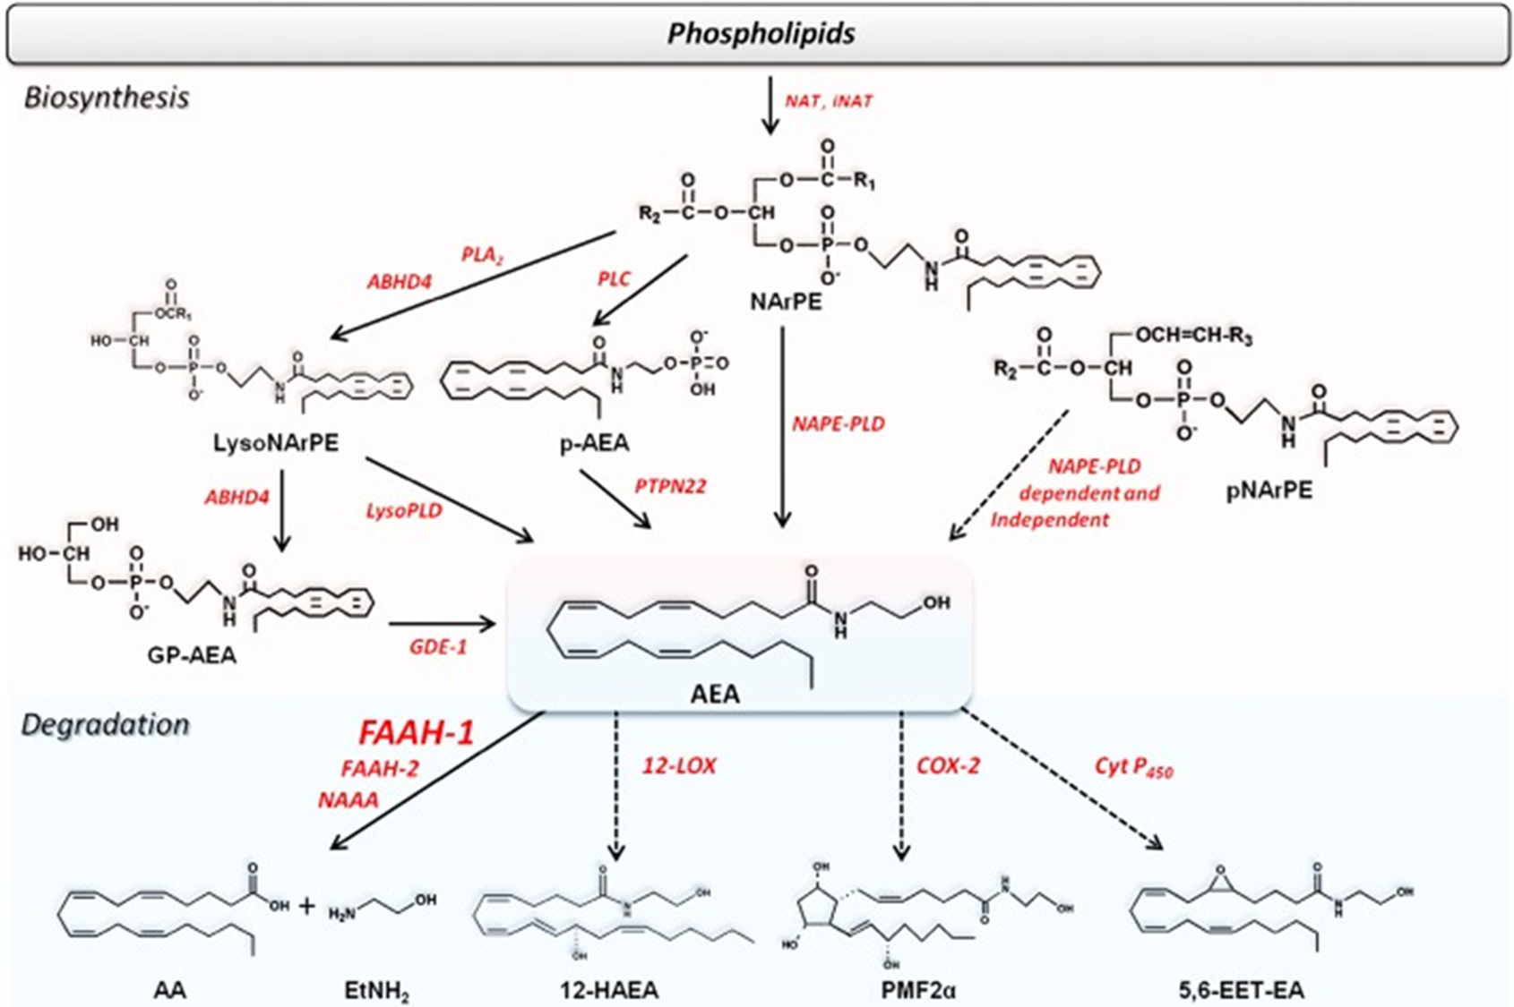
Biosynthesis of Anandamide
Oleoylethanolamide
Palmitoylethanolamide
Phosphatidylethanolamine (PE) and possibly PI and PC
NAT
iNAT
Oleoylethanolamide
Palmitoylethanolamide
https://www.ncbi.nlm.nih.gov/pmc/articles/PMC6271436/

Slide 8
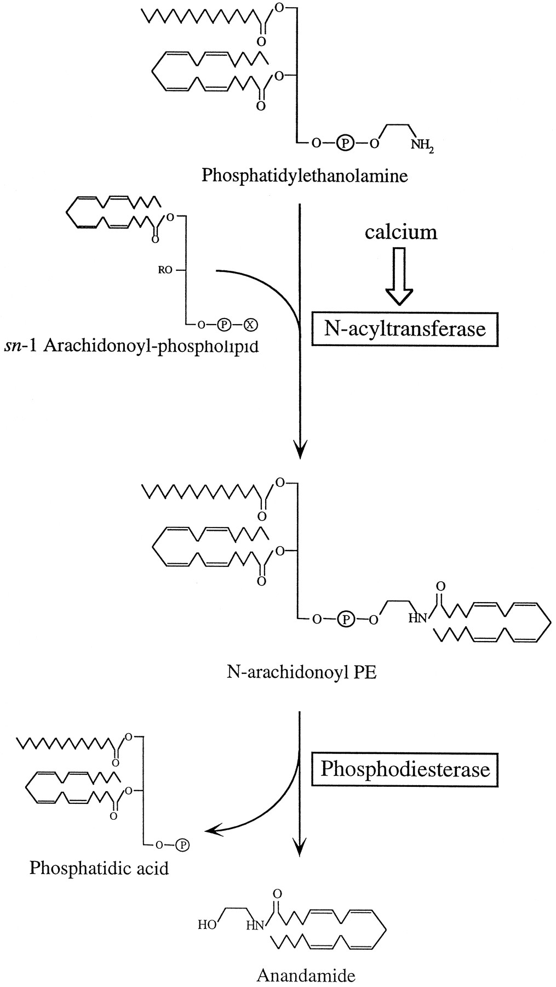
Nat transfers arachidonate from sn-1 arachidonoyl phospholipids to phospholipid PE yielding NaPE.
sn-2
sn-1
Nat
https://www.jneurosci.org/content/17/4/1226

Slide 9
sn-2
sn-1
Any Phospholipid can have arachidonate in the sn-1 position
Nat
https://www.jneurosci.org/content/17/4/1226

Slide 10
Ca2+ also stimulates PLD
Also works independent from Ca2+
PLD cleaves NaPE, freeing anandamide
PLD
https://www.jneurosci.org/content/17/4/1226

Slide 11
Degradation of Anandamide
URB597
Inflammation

Slide 12
Phosphatidylethanolamine (PE)
NAT
iNAT
Oleoylethanolamide
Palmitoylethanolamide
https://www.ncbi.nlm.nih.gov/pmc/articles/PMC6271436/

Slide 13
Biosynthesis of 2-Arachidonoylglycerol
PIP₂, phosphatidic acid (PAs), and phosphatidylcholine (PC)

Slide 14
Degradation of 2-Arachidonoylglycerol
JZL184
Inflammation

Slide 15
PIP₂, phosphatidic acid (PAs), and phosphatidylcholine (PC)
https://www.ncbi.nlm.nih.gov/pmc/articles/PMC6271436/

Slide 16
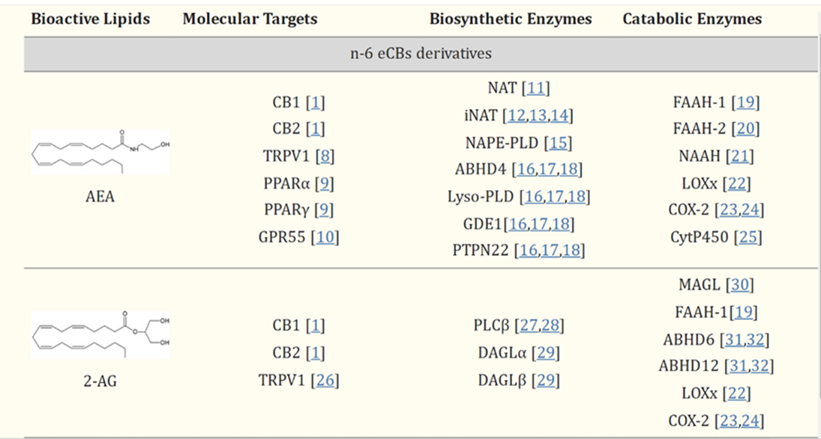
Movement to molecular targets is unknown.
Could be transported by proteins.
Could be concentration gradient dependent
Partial agonist
FULL agonist
Notes:
AEA shares many properties with THC, and acts as a partial agonist of CB₁ and as a weak partial agonist/antagonist of CB₂

Slide 17
Increased 2-Ag Increases Freezing During Fear Condition Extinction Events
Blocks AEA Degradation
Blocks 2-Ag Degradation
Notes:
main

Slide 18
Notes:
main

Slide 19
B1
B2
B3
B4
B5
Notes:
Data from fear extinction were expressed as percentage of freezing behavior and as area under the curve (AUC). AUC was calculated by using a standard trapezoid method, AUC = [0.5 × (B1 + B2) × h] + [0.5 × (B2 + B3) × h] + … [0.5 × (Bn+ Bn+1) × h], where Bn were the percentage of freezing behavior for each mouse and h was the time (days) passed between the consecutive measurements. Biochemical studies were carried out after the second extinction trial.

Slide 20
Intra-amygdala Infusion of the Orexin-A Impairs Fear Extinction
Notes:
main

Slide 21
Intra-amygdala Infusion of the Orexin-A increases 2-Ag
Notes:
main

Slide 22
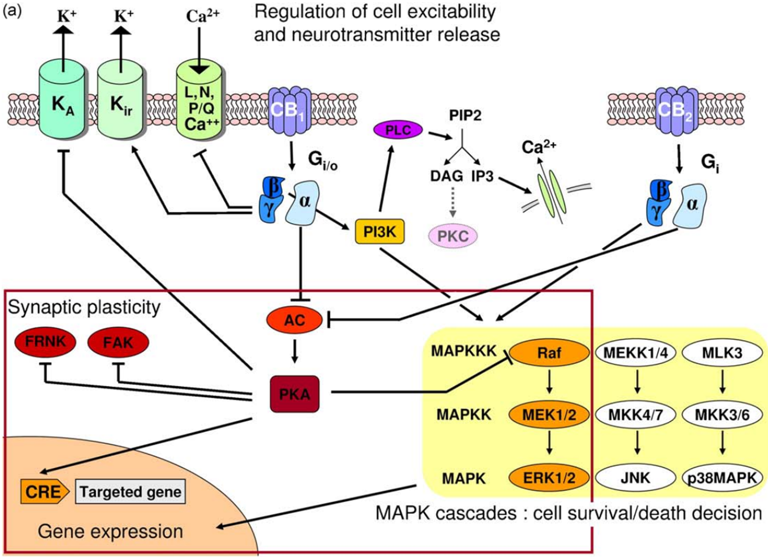
Cannabinoid 1 Receptors
Activates Gi/o Proteins
Antagonist
SR141716
CBD

Slide 23
Cannabinoid 1 Receptors
Activates Gi/o Proteins
Antagonist
Rimanobant
CBD
Cannabinoid 2 Receptors
Activates Gi Proteins
Antagonist
AM630
SR144528
Agonist
JWH133
CBD has Low affinity

Slide 24
Partial Agonist of both Cb₁ & Cb₂
AEA (high affinity for Cb₁)
Delta-9-THC
Full Agonist of both Cb₁ & Cb₂
2-Ag (high affinity for both)
CP-55,940

Slide 25
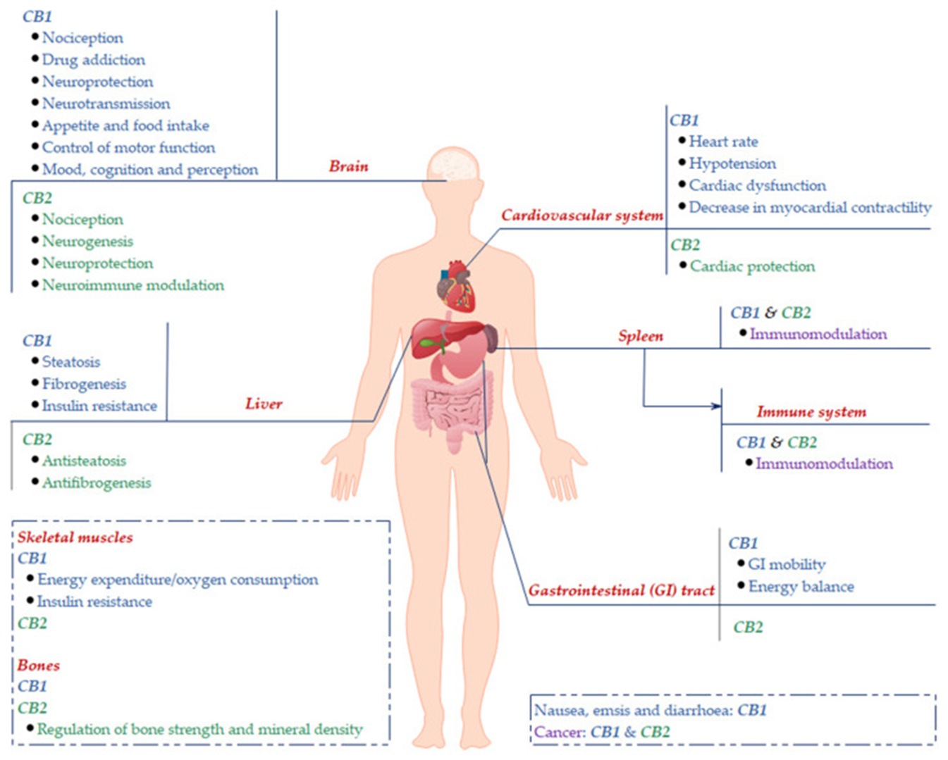
https://www.ncbi.nlm.nih.gov/pmc/articles/PMC7404216/

Slide 26
Cb₁ & Cb₂ activate G_{α} proteins that inhibit production of cAMP

Slide 27
Also activates β/γ:
Hyperpolarize cells
activate MAP Kinase pathways

Slide 28
β proteins activates PI₃K pathways act like a +Feedback loop
Increasing Orexin or any G_{q} signaling (OT)
Increasing 2-Ag Production
Increasing intracellular [Ca²⁺] driving AEA production

Slide 29
https://www.sciencedirect.com/science/article/abs/pii/S0006295210001553?via%3Dihub

Slide 30
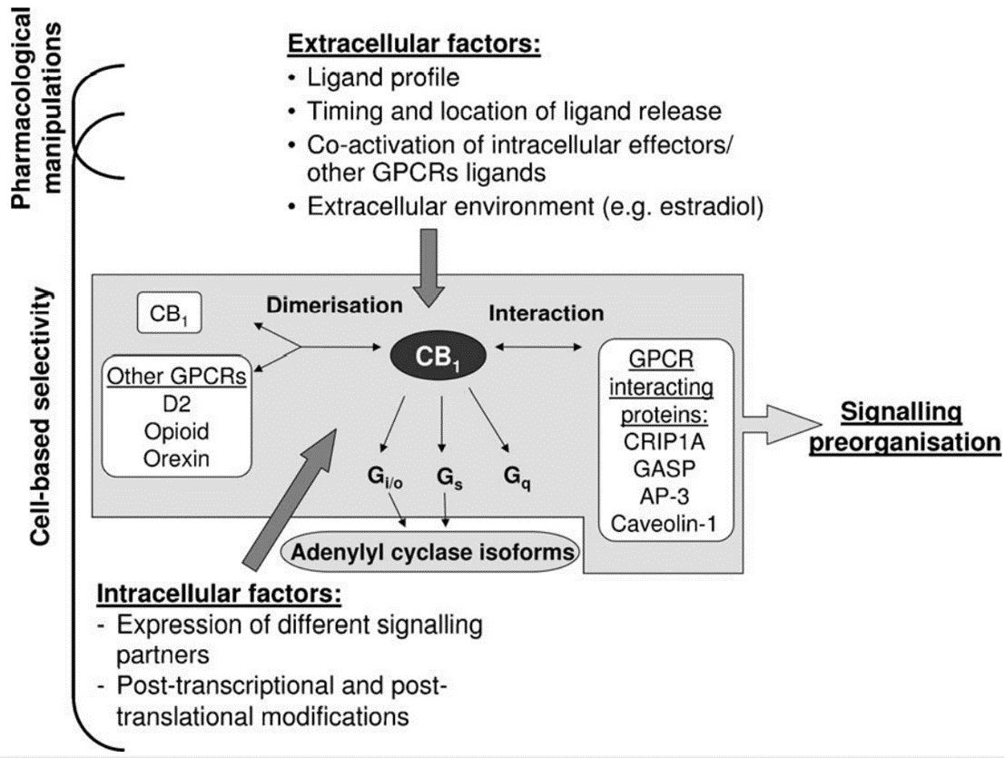
“Functionally Selective Cannabinoid Receptor Signaling”
https://www.sciencedirect.com/science/article/abs/pii/S0006295210001553?via%3Dihub
Notes:
cotreatment with a CB1R agonist and a dopaminergic D2R agonist increased cAMP levels in striatal neurons

Slide 31
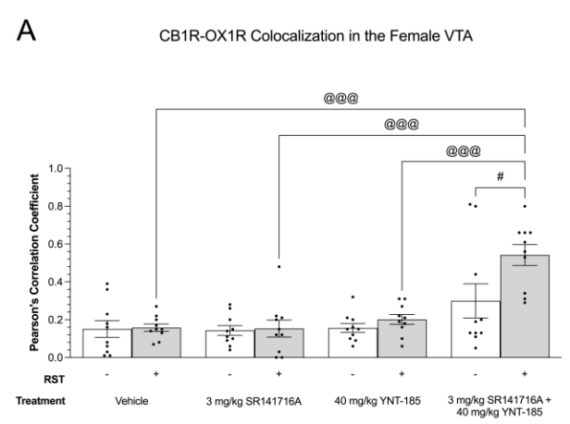
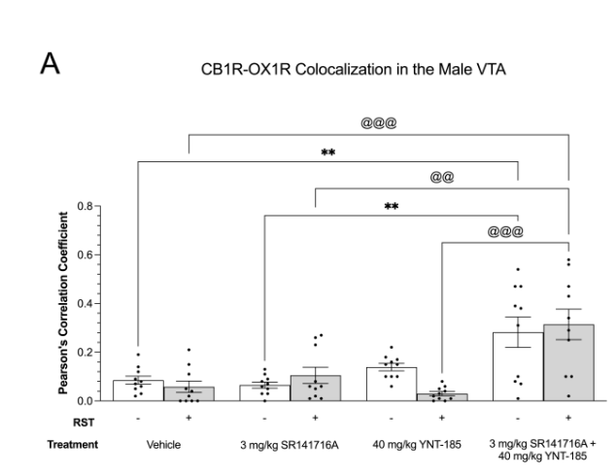
Immunohistochemistry of the Reward Centers
Increased colocalization of Cb₁-Orx₁ Receptors in the Female/Male VTA and Male NAC
Notes:
Pearson’s correlation coefficients were calculated as the overlapping fluorescent signals of either CB1R and OX1R, or CB1R and OX2R in cell bodies of DAPI-stained nuclei
3rd paper

Slide 32
Immunohistochemistry of the VTA
Increase Orx₁ & Cb₁ Colocalization in females
with combo drug treatments of YNT-185+Rimonabant
♀
Notes:
3rd paper

Slide 33
Immunohistochemistry of the VTA
Increase Orx₁ & Cb₁ Colocalization in males
Activating Orx₂ + Blocking Cb₁ increases Orx₁-Cb₁ colocalization
♂
Notes:
3rd paper

Slide 34
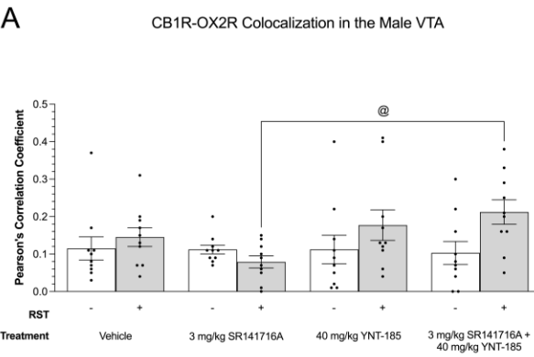
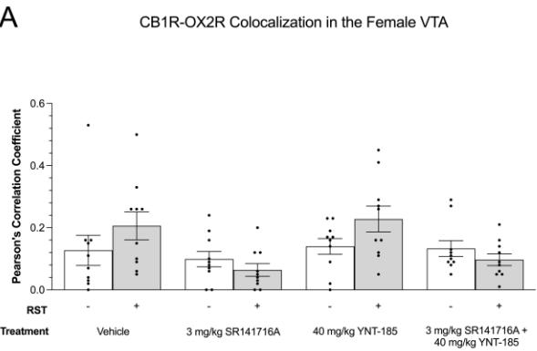
Colocalization of Cb₁-Orx₂ Receptors in the Female/Male VTA
Notes:
3rd paper

Slide 35
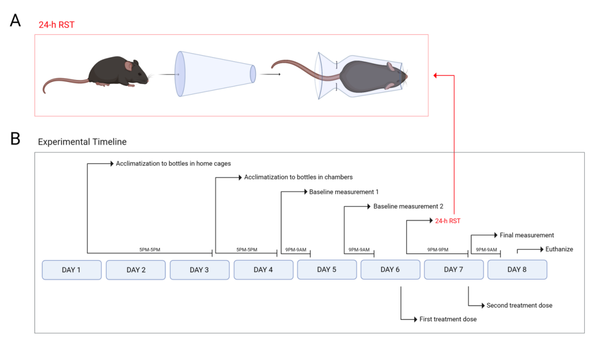
SPT
^
Notes:
3rd paper

Slide 36
“The inability to feel pleasure”
Notes:
3rd paper

Slide 37
Cb₁ Antagonist
Cb_{1/2}
Orx_{1/2}
Cb_{1/2}+Orx_{1/2}

Slide 38
Orx₂
Cb₁ Antagonist + Orx₂

Slide 39
Blocking Cb₁ with Intra-amygdala Infusion of Orexin-A Impairs Fear Extinction
Notes:
Main paper demonstrates this is not fear extinction is mediated by another Cb receptor

Slide 40
qPCR Data Demonstrate Increased Cb₂ Expression
Notes:
Main paper

Slide 41
Cb₂ Antagonist Decreases Freezing Restoring Fear Extinction

Slide 42
Robertson en al. 2017 qPCr Show Increased Cb₂ Expression
Control
Running wheel control No aggression
Social Aggression in SAM (Escape)
Social Aggression in SAM (STAY)
Running Wheel + SAM Social Aggression (Escape)
Running Wheel + SAM Social Aggression (Stay)
Notes:
Summers Robertson en al 2017 displaying high expression of Cb2 in mice that used the running wheel before running the SAM, displaying exercise effects on the endocannabinoid system

Slide 43
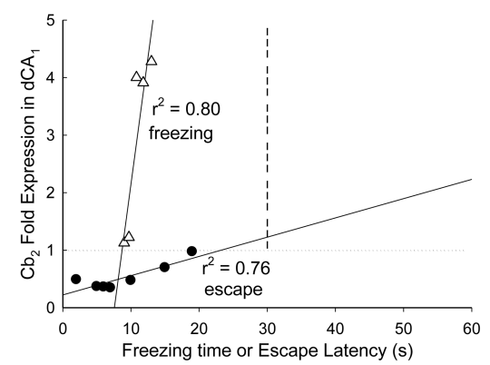
Robertson en al. 2017 Show Increased Cb₂ Expression
Notes:
Summers Robertson en al 2017 displaying high expression of Cb2 Correlates with anxiogenic behavior vs anxiolytic behavior

Slide 44
RST/Electric Shock/SAM
pCb
JWH133
Antagonist
AM630
SR144528
Cb2
Cb2
Orx1
Orx2
↓Inflammation
MAGL & FAAH inhibitors to increase eCb
DAGL inhibitor (O7460) to Decrease 2-Ag

Slide 45
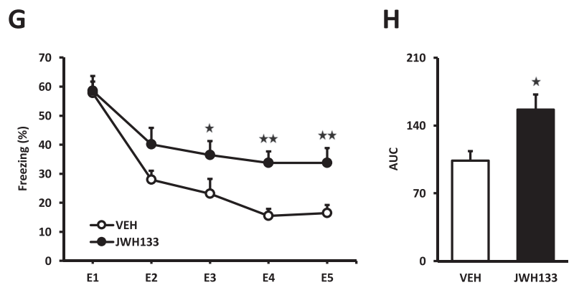
Cb₂ Agonist Increases Freezing
JWH133 Increased Freezing in mice subjected to Unconditioned Stimulus over 5 days.

Slide 46
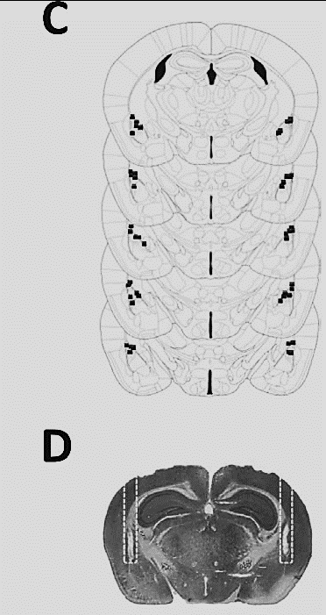
Cb₂ Agonist Increases Freezing

Slide 47
In-vitro Colocalization of Cb₂ and Orx₁ Receptors
Notes:
2nd paper

Slide 48
Parabolic Curve: Colocalization of Cb₂R and Orx₁R
Notes:
2nd paper

Slide 49
Colocalization of Cb₂ and Orx₁ Receptors In Vivo
Notes:
2nd paper

Slide 50
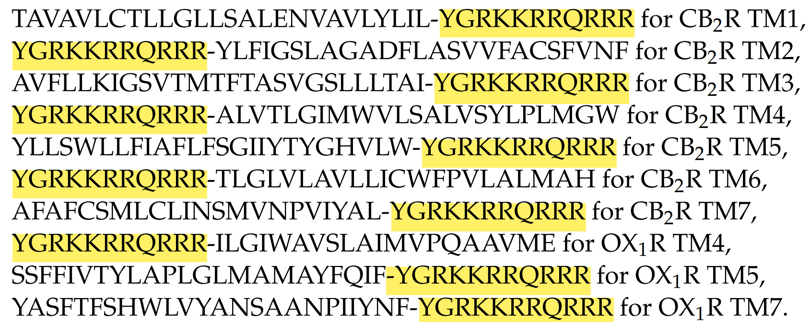
TAT Proteins Prevented Cb₂ & Orx₁ Tetrameric Complex

Slide 51
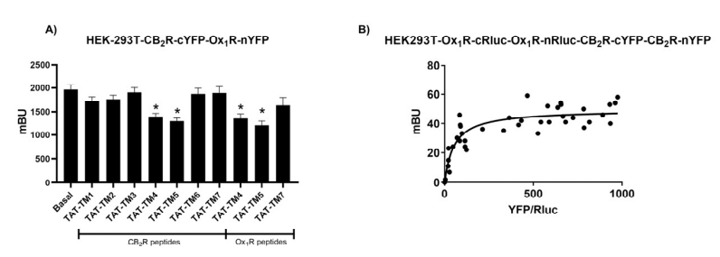
TAT Proteins Prevents YFP Signal of Tetramerize Complex

Slide 52
Tetramerization of Cb₂+Orx₁ Homodimers
Could exist on Neuron populations as well but the Paper focus on Microglia expression
Cb₂ Dimer
Cb₂ + Orx₁ Tetramer
Orx₁ Dimer

Slide 53
2-Ag and Anandamide act as opposite modulators of Fear Conditioning
Cb₁ can help modulate stressful behaviors brought on by Orexin 1 Receptors or Orexin-A.
Cb₂ shown to impair fear conditioning extinction and overexpress in different areas of the brain after running in stress paradigm.
CONCLUSION

Slide 54
Cb₁ Colocalization with Orexin 1 receptors have demonstrated possible heterodimerization causing internalization and receptor recycling
Cb₂ colocalization with Orx₁ shown in Microglia can form possible Tetrameric Complex of its homodimers
Blocking Orx₁ and activating Orx₂ can potentiate Cb receptors signaling. While Blocking Cb₂ receptors could regulate Orexin-A effect.
CONCLUSION

Slide 55
QUESTIONS??????

